Slide 1
Dynamic Programming
Longest Common Subsequence

Slide 2
Longest Common Subsequence
Problem: Given 2 sequences, X = ⟨x₁,...,x_{m}⟩ and
Y = ⟨y₁,...,y_{n}⟩, find a common subsequence whose length is maximum.
springtime ncaa tournament basketball
printing north carolina krzyzewski
Subsequence need not be consecutive, but must be in order.

Slide 3
Naïve Algorithm
For every subsequence of X, check whether it’s a subsequence of Y .
Time: Θ(n2^{m}).
  2^{m} subsequences of X to check.
  Each subsequence takes Θ(n) time to check:
  scan Y for first letter, for second, and so on.

Slide 4
Optimal Substructure
Theorem
Let Z = ⟨z₁, . . . , z_{k}⟩ be any LCS of X and Y .
1. If x_{m} = y_{n}, then z_{k} = x_{m} = y_{n} and Z_{k-1} is an LCS of X_{m-1} and Y_{n-1}.
2. If x_{m} ≠ y_{n}, then either z_{k} ≠ x_{m} and Z is an LCS of X_{m-1} and Y .
3. or z_{k} ≠ y_{n} and Z is an LCS of X and Y_{n-1}.
Notation:
prefix X_{i} = ⟨x₁,...,x_{i}⟩ is the first i letters of X.
This says what any longest common subsequence must look like;
do you believe it?

Slide 5
Optimal Substructure
Theorem
Let Z = ⟨z₁, . . . , z_{k}⟩ be any LCS of X and Y .
1. If x_{m} = y_{n}, then z_{k} = x_{m} = y_{n} and Z_{k-1} is an LCS of X_{m-1} and Y_{n-1}.
2. If x_{m} ≠ y_{n}, then either z_{k} ≠ x_{m} and Z is an LCS of X_{m-1} and Y .
3. or z_{k} ≠ y_{n} and Z is an LCS of X and Y_{n-1}.
Proof: (case 1: x_{m} = y_{n})
Any sequence Z’ that does not end in x_{m} = y_{n} can be made longer by adding x_{m} = y_{n} to the end. Therefore,
longest common subsequence (LCS) Z must end in x_{m} = y_{n}.
Z_{k-1} is a common subsequence of X_{m-1} and Y_{n-1}, and
there is no longer CS of X_{m-1} and Y_{n-1}, or Z would not be an LCS.

Slide 6
Optimal Substructure
Theorem
Let Z = ⟨z₁, . . . , z_{k}⟩ be any LCS of X and Y .
1. If x_{m} = y_{n}, then z_{k} = x_{m} = y_{n} and Z_{k-1} is an LCS of X_{m-1} and Y_{n-1}.
2. If x_{m} ≠ y_{n}, then either z_{k} ≠ x_{m} and Z is an LCS of X_{m-1} and Y .
3. or z_{k} ≠ y_{n} and Z is an LCS of X and Y_{n-1}.
Proof: (case 2: x_{m} ≠ y_{n}, and z_{k} ≠ x_{m})
Since Z does not end in x_{m},
Z is a common subsequence of X_{m-1} and Y, and
there is no longer CS of X_{m-1} and Y, or Z would not be an LCS.

Slide 7
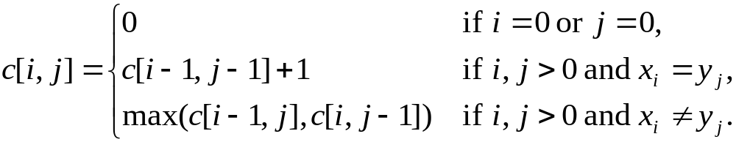
Recursive Solution
Define c[i, j] = length of LCS of X_{i} and Y_{j} .
We want c[m,n].
This gives a recursive algorithm and solves the problem.
But does it solve well?

Slide 8
Recursive Solution
c[springtime, printing]
c[springtim, printing] c[springtime, printin]
[springti, printing] [springtim, printin] [springtim, printin] [springtime, printi]
[springt, printing] [springti, printin] [springtim, printi] [springtime, print]

Slide 9
Recursive Solution
 |  | p | r | i | n | t | i | n | g
s
p
r
i
n
g
t
i
m
e
Keep track of c[i,j] in a table of nm entries:
  bottom/up

Slide 10
Computing the length of an LCS
LCS-LENGTH (X, Y)
m ← length[X]
n ← length[Y]
for i ← 1 to m
do c[i, 0] ← 0
for j ← 0 to n
do c[0, j ] ← 0
for i ← 1 to m
do for j ← 1 to n
do if x_{i} = y_{j}
then c[i, j ] ← c[i−1, j−1] + 1
b[i, j ] ← “ ”
else if c[i−1, j ] ≥ c[i, j−1]
then c[i, j ] ← c[i− 1, j ]
b[i, j ] ← “↑”
else c[i, j ] ← c[i, j−1]
b[i, j ] ← “←”
return c and b
b[i, j ] points to table entry whose subproblem we used in solving LCS of X_{i}
and Y_{j}.
c[m,n] contains the length of an LCS of X and Y.
Time: O(mn)

Slide 11
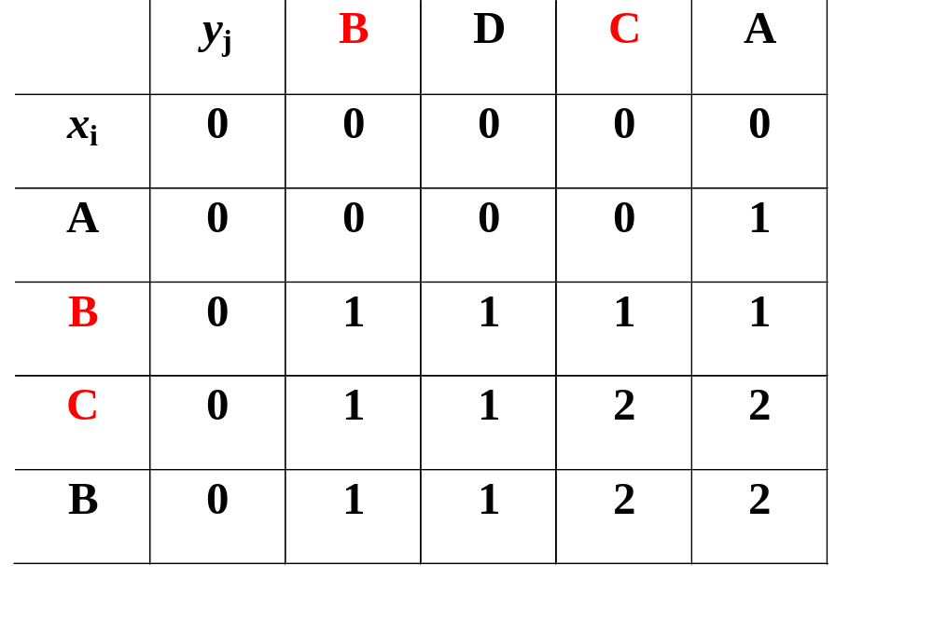
Example
To find an LCS follow the arrows, for each
diagonal arrow there is a member of the LCS

Slide 12
Constructing an LCS
PRINT-LCS (b, X, i, j)
if i = 0 or j = 0
then return
if b[i, j ] = “ ”
then PRINT-LCS(b, X, i−1, j−1)
print x_{i}
elseif b[i, j ] = “↑”
then PRINT-LCS(b, X, i−1, j)
else PRINT-LCS(b, X, i, j−1)
Initial call is PRINT-LCS (b, X,m, n).
When b[i, j ] = , we have extended LCS by one character. So LCS = entries with in them.
Time: O(m+n)

